Slide 1


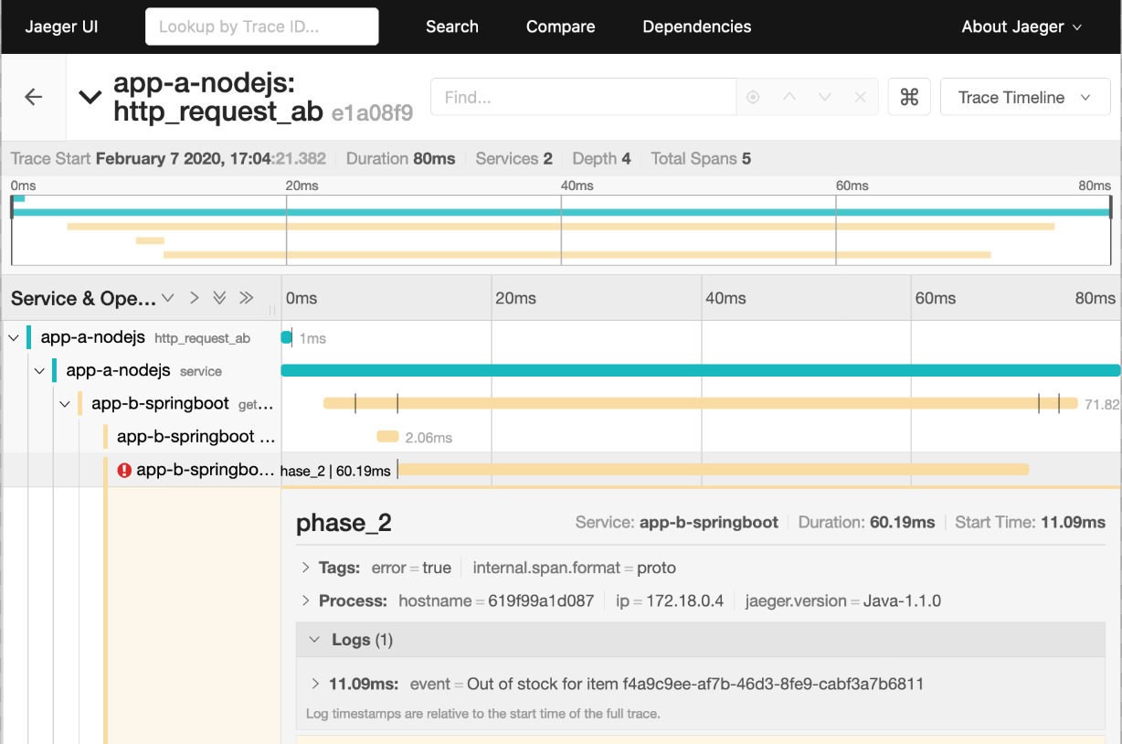



Transaction #2
Business transaction
JEE Application “C”
OpenTracing traffic
Transaction #1
Node.js Application “A”
Spring Boot Application “B”
Istio
Transaction #1 Span
A = 20 ms
B = 16 ms
Transaction #2 Span
Jaeger Backend
Jaeger UI
A = 25 ms
C = 6 ms

Slide 2
Transaction #2
JEE Application “C”
Transaction #1
Node.js Application “A”
Spring Boot Application “B”
Kiali UI
Jaeger Backend
Jaeger UI
Business transaction
OpenTracing traffic

Slide 3
JEE Application
Istio
Node.js Application
Spring Boot Application
Transaction #1 Span
A = 20 ms
B = 16 ms
Transaction #2 Span
Jaeger Backend
A = 25 ms
C = 6 ms

Slide 4
Request
Application “A”
Application “B”
Create span “estimate order cost”
Create span “quote item”
Trace id: 21877abc213ef
Span “estimate order cost”
Span ”quote item”
Jaeger Backend
Jaeger UI
Business transaction
OpenTracing traffic

